Slide 1
Analyzing the Conditions Contributing to Covid-19 Deaths
INFO 634 Data Mining, Group 3
Akhila Singanal, Alicia Brandemarte, Manoj Venkatachalaiah and Srilakshmi Rao

Slide 2
Introduction
Our project team objective was to find patterns in Covid-19 data released by the CDC, along with an additional location based public health and mask mandate dataset.
We merged the three datasets to identify the patterns that are interesting and beneficial to the public health community, and examine the key conditions that are causing Covid-19 deaths.
We performed exploratory data analysis and applied various regression algorithms to our dataset upon completion of data pre-processing, to predict the number of Covid-19 deaths in each state.

Slide 3
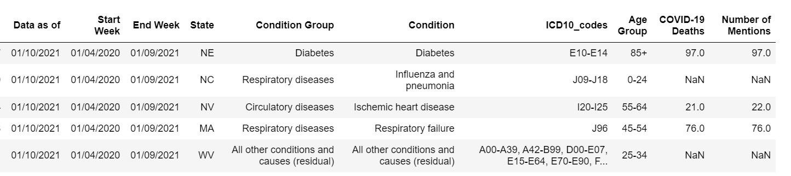
Description of Datasets
CDC dataset contains 12,420 instances and 11 features at state level. 11% missing values.
9 nominal, 2 numeric
Each row has the total number of covid-19 deaths for the year 2020 for each of the 50 states, which is further classified based on medical conditions and age groups.

Slide 4
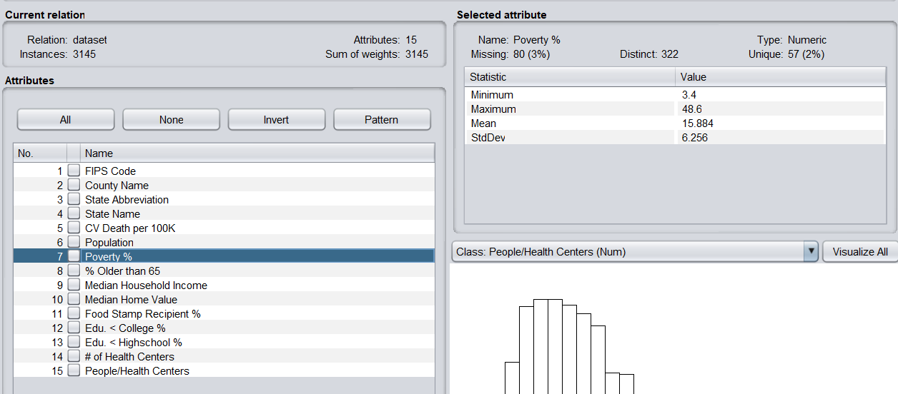
Description of Datasets, Cont.
Public health dataset contains 3,145 instances at county level, 14 features and 5.6% missing values
3 nominal, 12 numeric

Slide 5
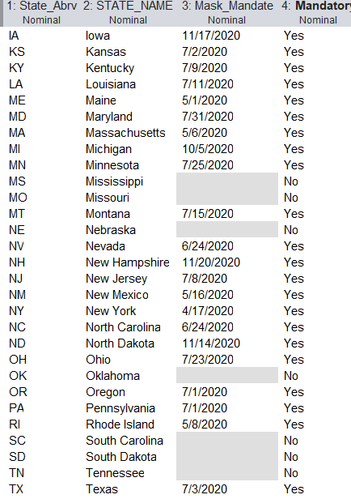
Description of Datasets, Cont.
Mask mandate dataset contains 52 instances (states & territories). 4 attributes, 14% missing values for start date.
All features are nominal

Slide 6
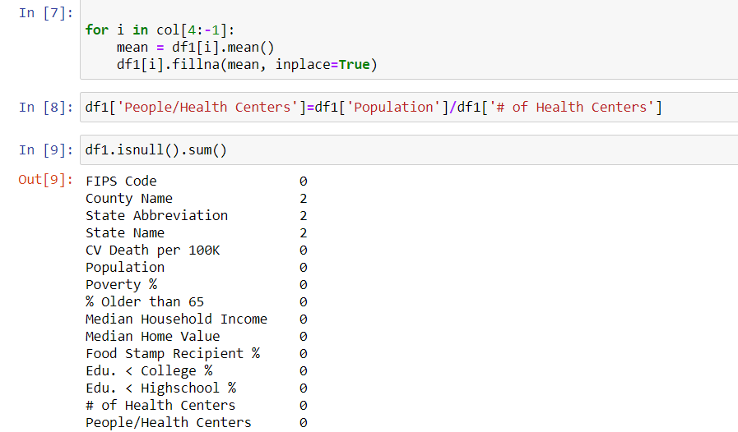
Data Cleaning
Filling the missing values in the Public health dataset:
All numerical feature NaNs are replaced with the means of the corresponding columns.
We dropped the two instances that had NaN values for categorical columns.

Slide 7
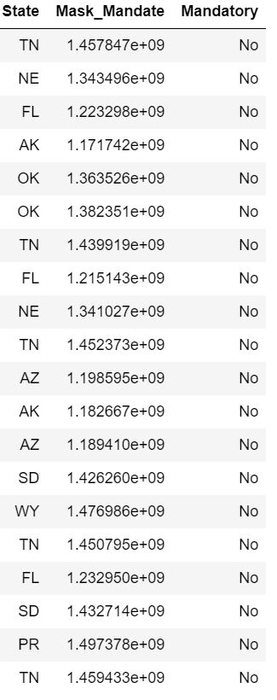
Data Cleaning : Mask Mandate
We converted the dates to date stamps and filled the missing values with means of corresponding rows

Slide 8
Additional Pre-Processing for Modeling
Dropped “Number of Mentions” feature
Dropped Data as Of, Start Week and End Week features
Converting date strings to timestamp
Standardized numeric data for linear regression modeling

Slide 9
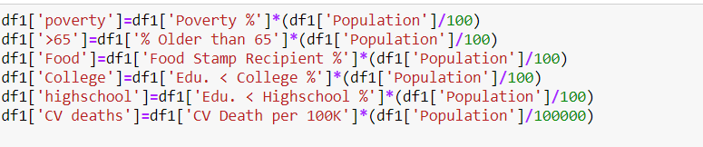
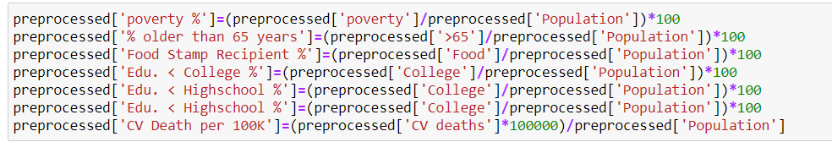
Feature Engineering
All the numerical features are calculated for each state in the public health dataset by grouping the counties. Percentages are first converted to actual values and then grouped based on State codes. These values are then converted to percentages.

Slide 10
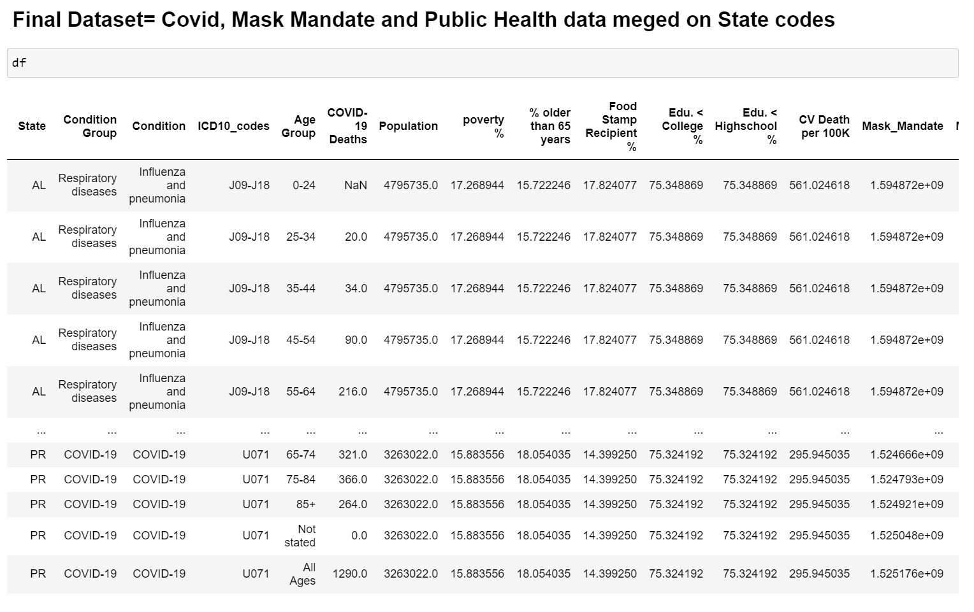
Merging
Datasets
Final Dataset features:
'State', 'Condition Group',
'Condition', 'ICD10_codes',
'Age Group', 'COVID-19 Deaths',
'Population', 'poverty %',
'% older than 65 years',
'Food Stamp Recipient %',
'Edu. < College %',
'Edu. < Highschool %',
'CV Death per 100K',
'Mask_Mandate', 'Mandatory'

Slide 11
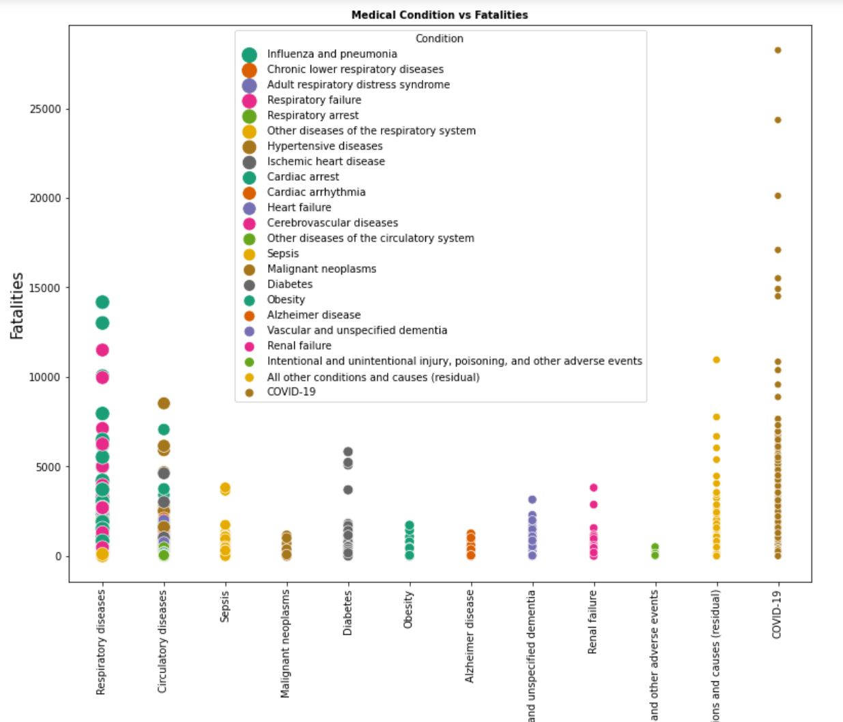
Exploratory
Data Analysis
Medical Condition vs. Covid-19 Fatalities :
Respiratory diseases such as Influenza and conditions such as Respiratory failure seem to have the highest Covid-19 deaths.

Slide 12
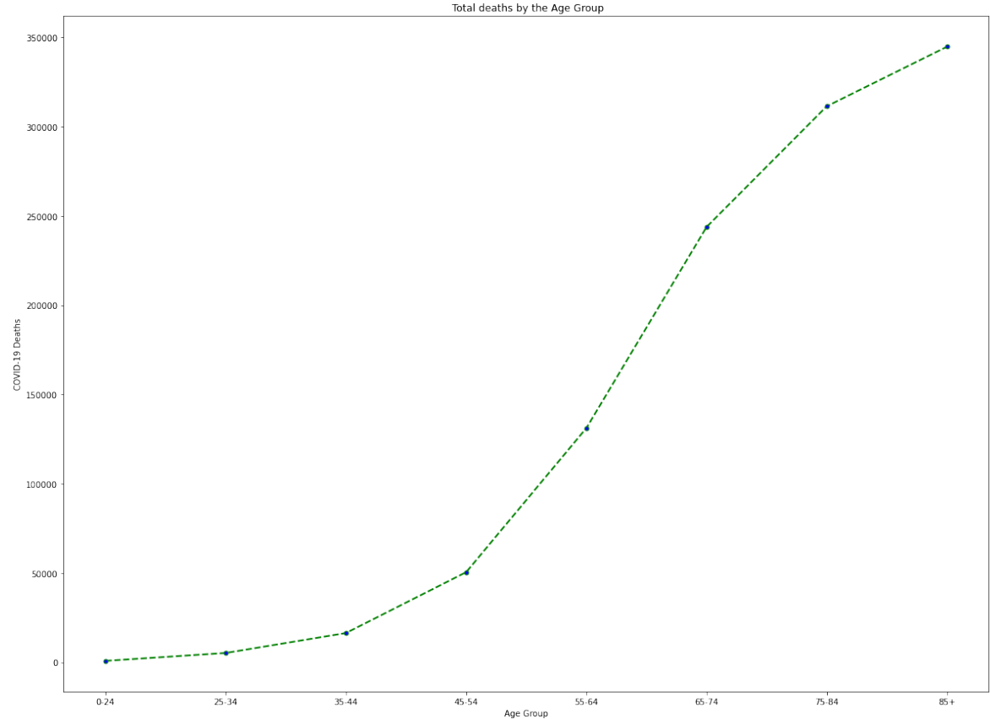
Exploratory
Data Analysis
2) Age Group vs. Total Covid-19 Deaths
Some of the older age groups seem to have more Covid-19 deaths than the younger ones

Slide 13
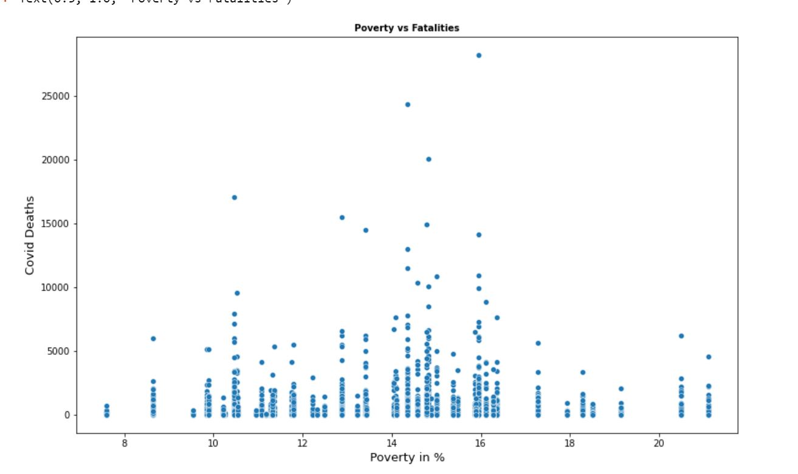
Exploratory
Data Analysis
3) Poverty vs. Total Covid-19 Deaths
We have a normal distribution for the attribute ‘Poverty %’

Slide 14
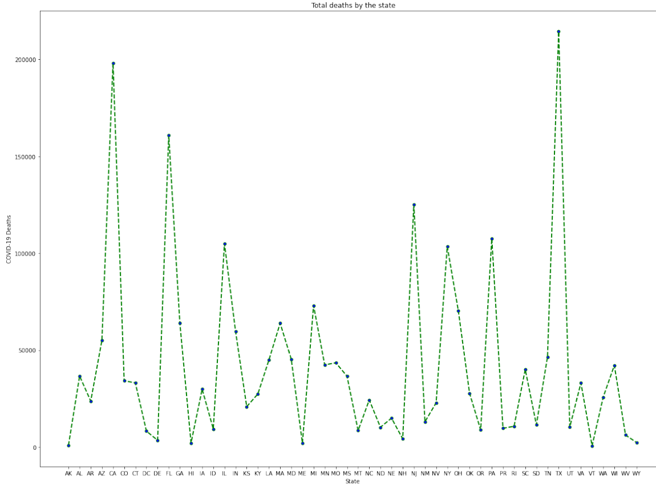
Exploratory
Data Analysis
4) Total Covid-19 Deaths by State
California, New York, Florida and Texas have had the most number of deaths.

Slide 15
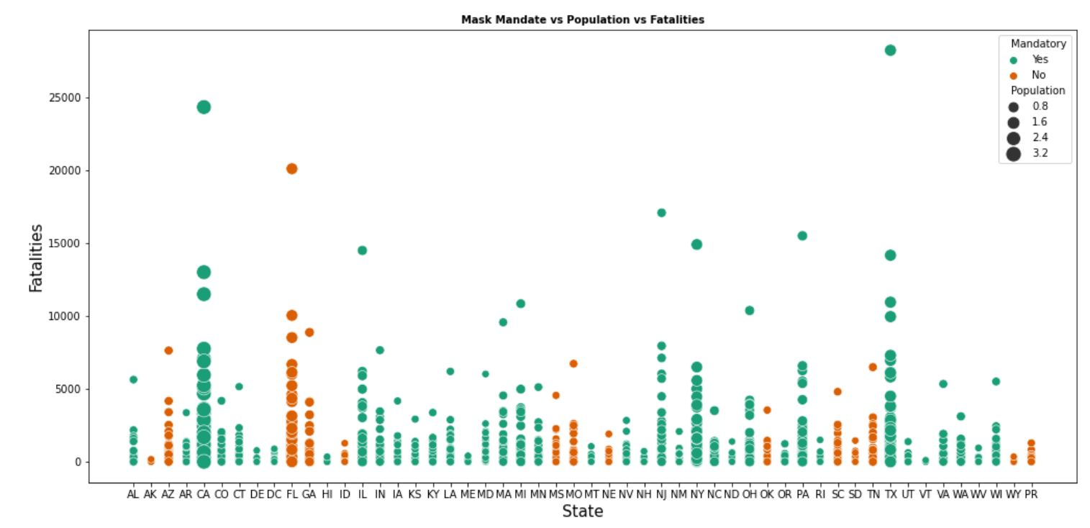
Exploratory
Data Analysis
5) Mask mandate vs Population vs Deaths

Slide 16
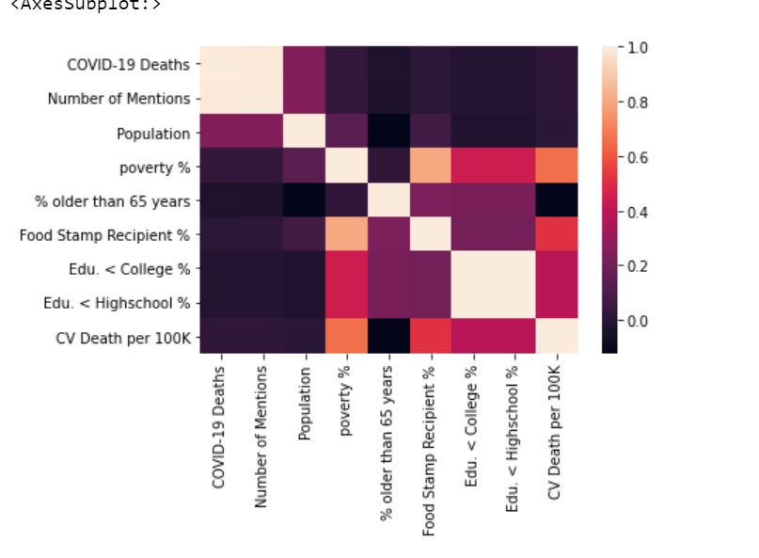
Exploratory
Data Analysis
6) Correlation between Covid-19 deaths and numerical features
The attribute ‘poverty’ has a decent correlativity with few attributes
Covid-19 deaths doesn’t seem to have good correlativity scores,

Slide 17
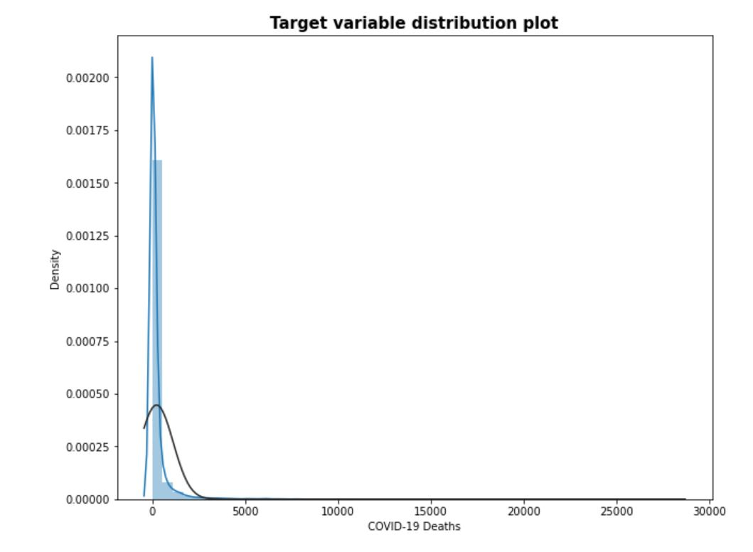
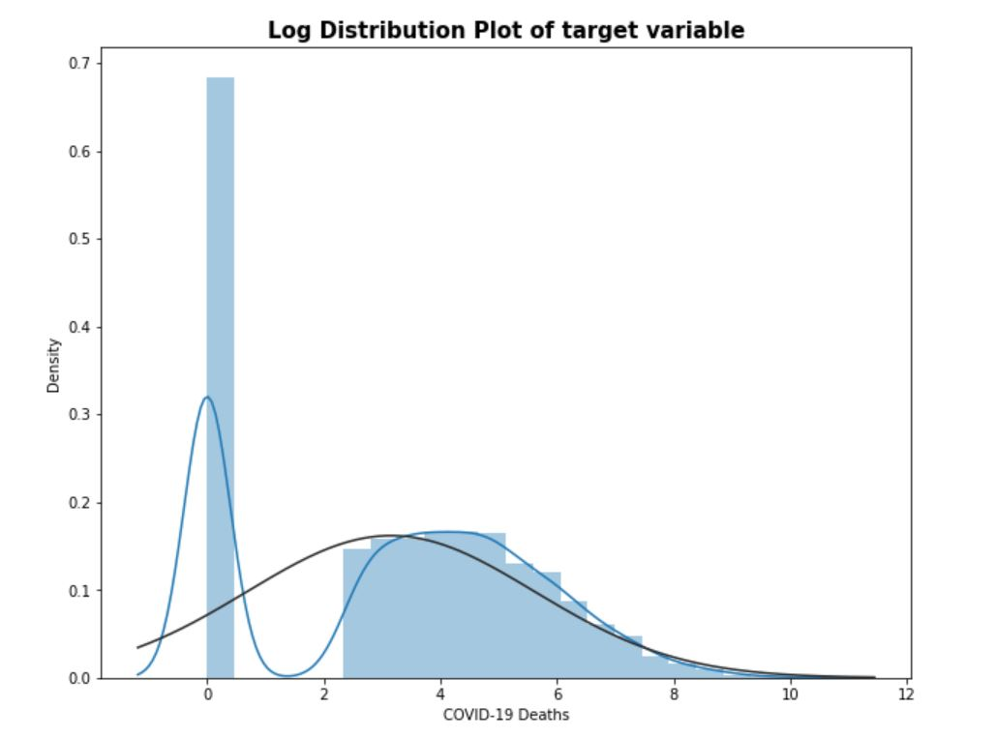
Log-transforming the Target variable: Covid-19 deaths
Log-transforming the target variable will give us a more normal distribution and help during the predictive modeling stage.

Slide 18
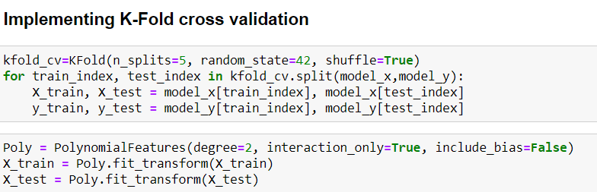
Predictive Modeling
Methods used for Predictive Modeling
Linear Regression
Decision Tree
SVM
Random Forest
Trained Model using training set
Trained Model using k-fold cross validation

Slide 19
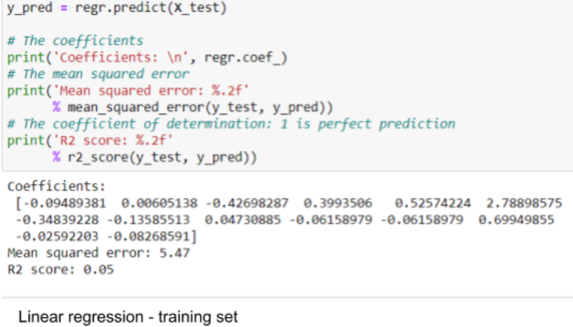
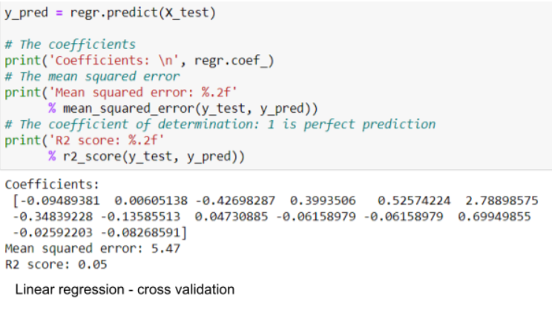
Methods - Algorithms
Linear Regression

Slide 20
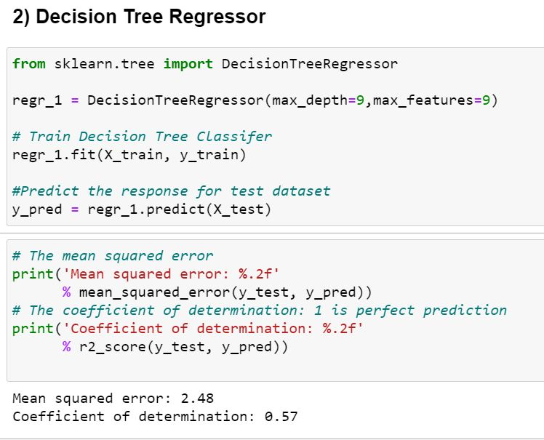
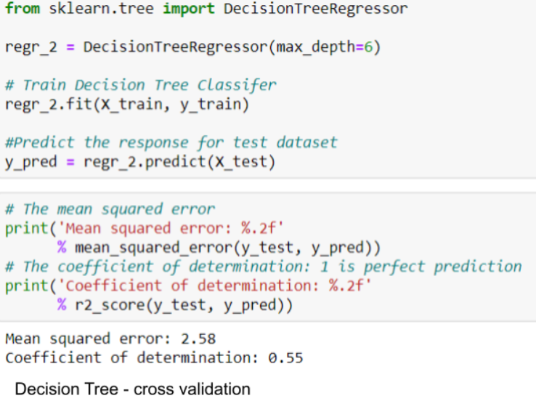
Methods - Algorithms
Decision Tree-Training set
Decision Tree-Cross Validation

Slide 21
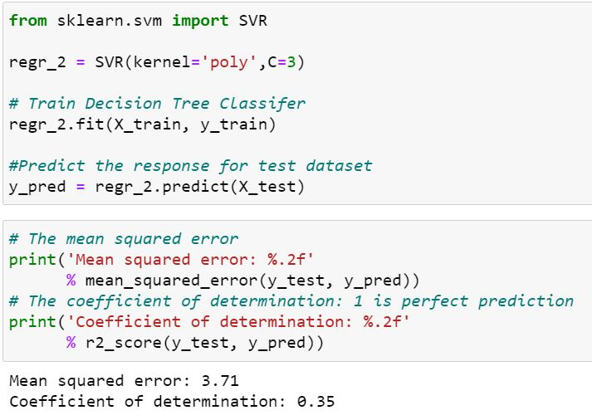
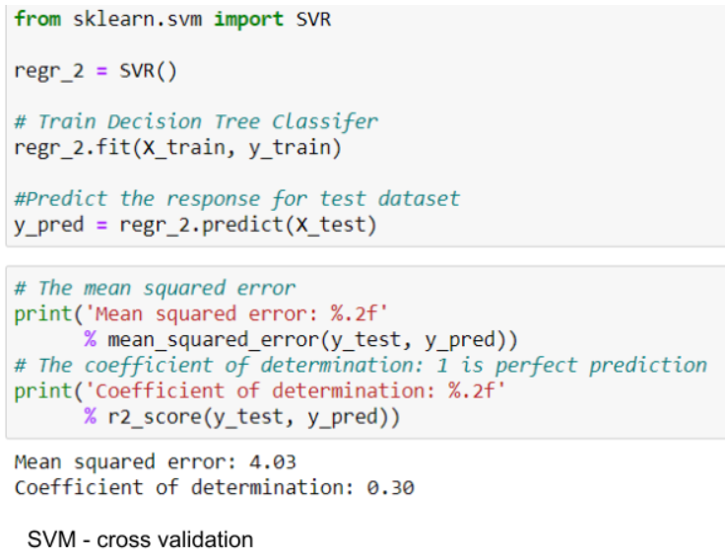
Methods - Algorithms
SVM
SVM- Training set

Slide 22
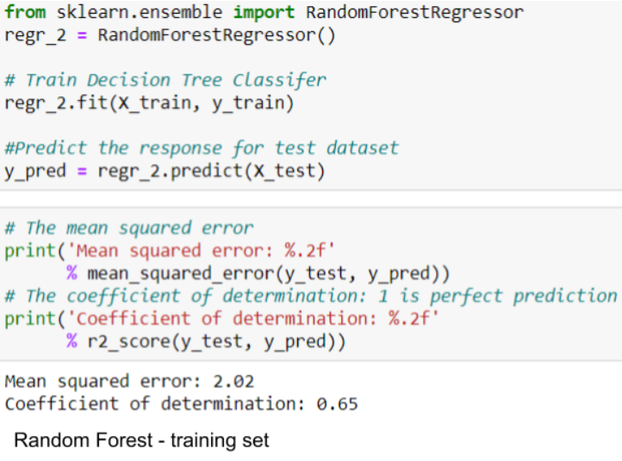
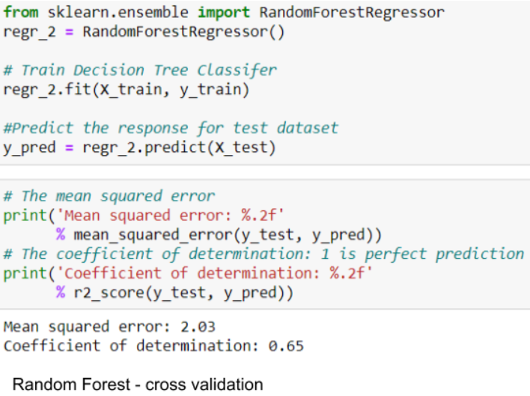
Methods - Algorithms
Random Forest

Slide 23
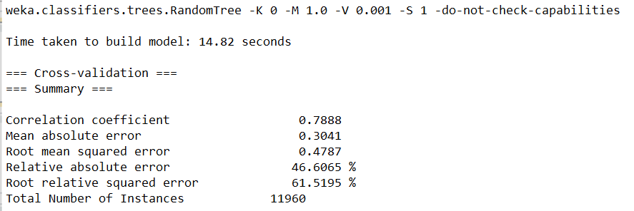
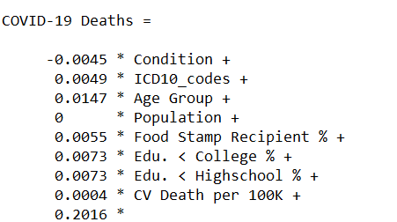
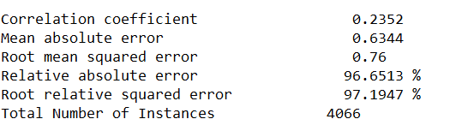
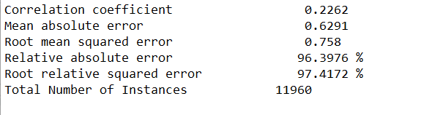
Methods - Algorithms in Weka
Linear Regression 66% Split:
Random Forest, 10 fold cross validation:
Linear Regression, 10 fold cross validation:

Slide 24
Analysis and Conclusion
EDA:
Categorical attributes such as poverty %, population, medical condition, age group and mask_made showed expected trends when plotted against covid-19 deaths
The number of deaths increased as poverty % and population increased, it also seemed to be high for respiratory medical conditions among older age groups.
The target variable initially had a skewed distribution, but showed a more normal distribution after log transformation, which helped the prediction
Predictive modeling:
Tree based algorithms such as Decision Tree and Random Forest produced the best results with R2 scores of 0.57 and 0.78 respectively.
This could be because of the fact that our dataset had a lot of categorical attributes that had an effect on the target variable that numerical attributes didn’t.

